Slide 1
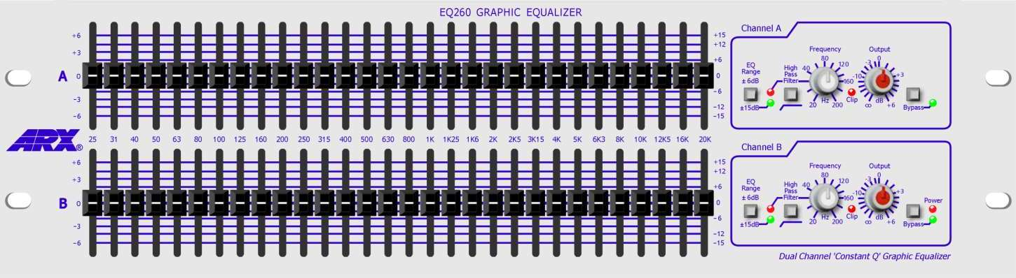
Graphic EQ

Slide 2
Tone controls
Most common equalisation is the tone control
Controls: bass and treble
Adjust sound to suit your taste, or the room
Bass control = lowpass shelving filter
Treble control = highpass shelving filter
Control centred = unity gain = flat response
Boost
Boost
Cut
Cut

Slide 3
Tone controls
Compare shelving filters to standard lowpass and highpass filters
Most filters try to completely remove low or high frequencies
Here, just want to boost or cut a portion
|H|²
|H|²
High-pass
1
Low-pass
1
Cutoff frequency
Where response changes between 2 levels
Can design adjustable cutoff as well as level
0
ω_{c}
π
0
ω_{c}
π
|H|²
|H|²
High Shelving Filter
G
Low Shelving Filter
G
1
1
0
ω_{c}
π
0
ω_{c}
π

Slide 4
Tone controls - Midrange
In addition to bass and treble, midrange control
Affects frequencies between highs and lows
boost or cut portion of spectrum without affecting the rest
Does not attempt to isolate particular frequencies
Rarely, adjustable center frequency
Where gain is at maximum (or minimum)
Boost
Cut

Slide 5
(a) Bass and treble tone controls implemented as a low shelving filter and high shelving filter placed in series. (b) Three tone controls, including a peaking/notch filter to adjust the midrange.
Bass
Treble
(a)
x[n]
y[n]
Low shelf
High shelf
(b)
Bass
Mids
Treble
x[n]
y[n]
y[n]
Low shelf
Peaking/ notch
High shelf

Slide 6
Tone controls - Summary
2 or 3 controls: bass, mid, treble
Implemented with shelving and peaking filters
Filters connected in series
Able to adjust level of each section
Sometimes but rarely, adjustable cutoff frequencies
Q is usually fixed

Slide 7
Presence and loudness
Some amplifiers have a presence knob as part of tone controls
Boosts mid-to-high frequencies, 2-6kHz
Alter recorded instrument’s sound to give sense of presence in the room with listener
Can help an instrument stand out more in a mix
Many amplifiers also have a loudness control
Louder? Isn’t this the volume knob?

Slide 8
Loudness
Human hearing is nonlinear
Perceived loudness depends on frequency as well as SPL
Loudness control designed for listening at low volume
Boost bass and treble to simulate higher-volume listening
90 phon- top curve
Each curve represents Sound Pressure Level (SPL) required for listener to perceive constant loudness when presented with pure tones across frequency range
10 phon- bottom curve

Slide 9
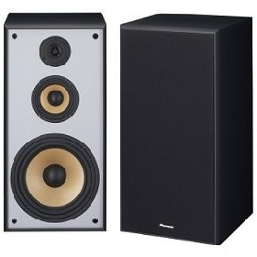
Speakers and crossovers
Hard to design speaker/cabinet with flat response over the whole audio range
Need more than one speaker to cover whole range
Send specific frequencies to each speaker
Tweeters can be damaged by low frequencies
Woofers sound terrible at high frequencies
Use a crossover to separate frequencies
Tweeter (high freq.)
Midrange (mid freq.)
Woofer (low freq.)

Slide 10
Speakers and crossovers
Crossover - network of filters that splits audio into components for each speaker
In 2-way (woofer and tweeter) system
Lowpass for woofer
Highpass for tweeter
Same cutoff frequency for both
Often use Butterworth filters (maximally flat freq. resp.)
Not shelving type filters
In 3-way system
Lowpass, bandpass, and highpass
Can be implemented with lowpass, then lowpass and highpass
Two relevant cutoff frequencies

Slide 11
A loudspeaker crossover
x[n]
(a)
Low pass filter
High pass filter
Separates the signal into different frequency bands that the various speakers can handle
2-way (a) and 3-way (b) loudspeaker crossovers are depicted
y_{LP}[n]
y_{HP}[n]
Woofer
Tweeter
x[n]
(b)
Low pass filter
High pass filter
Low pass filter
High pass filter
y_{LP}[n]
y_{BP}[n]
y_{HP}[n]
Woofer
Midrange
Tweeter

Slide 12
Equalisation
Definition
Boosting or cutting certain frequency components in a signal
Equalisation (EQ) is a form of filtering
Filters are class of systems that change magnitudes and phases of input signal in a frequency-dependent manner
Usually linear and time-invariant
Origin
Trying to obtain flat frequency response
No colouration
Example
Transmitting analogue voice signal over long distance
Transmission line attenuates high frequencies
Apply equalisation filters to correct loss, resulting in more natural sound on the other end

Slide 13
Introduction
Graphic equalisers let user set gains for fixed frequency bands
Gain of each band generally controlled with slider
Band distribution is logarithmic in frequency
Matches human perception
Common designs include 1-octave and 1/3-octave bands
In live performance, delay can be a concern
Every audio device needs lowest possible latency
Use recursive (IIR) filters instead of FIR
General IIR filter design is computationally expensive
Equaliser implemented as collection of sub-filters, each of which affects one band only

Slide 14
More on graphic EQ
More flexible than tone control
More frequency bands available
6 to 40 bands is typical range
Like tone controls, centre frequencies are fixed
Boost or cut controlled with sliders
slider positions represent samples of magnitude response at different frequencies
Give ‘graphic’ representation of frequency response
Use in sound reinforcement and tuning rooms
Achieve flat frequency response for sound system
Resonances of room/speakers can colour sound
Counteract coloration with graphic equaliser
At instrument level, stomp-box equalisers provide both volume boost and tone change for soloing

Slide 15
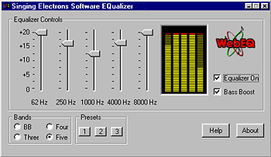
Graphic Equalisers and sliders
Manipulate each frequency band independently by inserting gain control
sliders on front of equaliser are gain controls in each band

Slide 16
Graphic EQ and octaves
Centre frequencies usually equally spaced in octaves
Logarithmic, not linear, in frequency
octave is factor of 2 (or 2¹)
1/3 octave spacing based on factor of 2^{1/3} ~ 1.26
Examples
1 octave spacing starting at 100Hz would have...
200Hz, 400Hz, 800Hz, 1.6kHz, ...
1/3 octave spacing starting at 100Hz would have...
126Hz, 159Hz, 200Hz, 252Hz, 318Hz, 400Hz, ...
ISO standard for preferred frequencies to use

Slide 17
Parallel implementation
Consider as bank of bandpass filters
Completely isolate individual frequency bands
Real bandpass filters may have ripple in passband and don’t have a perfectly sharp cutoff
Arrange filters in parallel
Each has same input
Outputs summed (mixed) after band gains adjusted
x[n]
...
|H|²
B
1
Band-pass
Bandpass
Filter
Bandpass
Filter
Bandpass
Filter
...
0
ω_{c}
π
y[n]
+

Slide 18
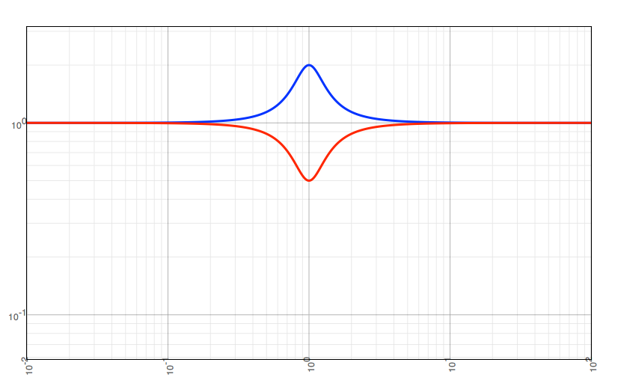
Series implementation
Consider cascade of peaking or shelving filters
Add a boost or notch to a specific frequency band
Top and bottom bands may be shelving filters which extend to edge of spectrum
Each filter has gain of 1 outside the band
Arrange filters in series
Each takes its input from the previous filter
Boost/Cut
Level
Boost/Cut
Level
Boost/Cut
Level
Boost/Cut
Level
Boost/Cut
Level
Peak/Notch
Peak/Notch
Peak/Notch
...
Peak/Notch
Peak/Notch
x[n]
y[n]
50Hz
100Hz
200Hz
6.4kHz
12.8kHz
Gain of 1 (0dB)
Shelving LP
Shelving HP
50Hz
12.8kHz
(variation)
(variation)

Slide 19
Design using shelving filters
Specify frequencies for i^{th} band
Let normalised lower cutoff be ω_{l,i} and upper cutoff ω_{u,i}
Bandwidth B_{i}= ω_{u,i} -ω_{l,i}
Centre frequency is approx. geometric mean
Require frequency bands to be adjacent: ω_{u,i} =ω_{l,i +1}
Logarithmic distribution specified as follows
By cutoff frequencies ω_{l,i+1}=R ω_{l, i}
Equivalently, by centre frequencies ω_{c,i+1}=R ω_{c, i}
Implies B_{i+1}=R B_{i}
Notice: constant Q_{i} =ω_{c,i} /B_{i}
For octave equaliser, R=2
For 1/3 octave equaliser, R=

Slide 20
Design Using Shelving Filters
Parameters in terms of band centre frequencies
Subfilters ideally have magnitude of G_{i} inside band and unity gain outside that band
In practice, subfilters have transitional regions around band edges

Slide 21
Design using shelving filters
When same gain used in adjacent bands, want flat magnitude response
Requires filters to have complementary band-edges
In general, we have
So when G_{i} =G_{i+1} =G , need:
When different gain used in adjacent bands
Need filter edges to be sharp to minimise interband influence
Requires higher-order filters

Slide 22
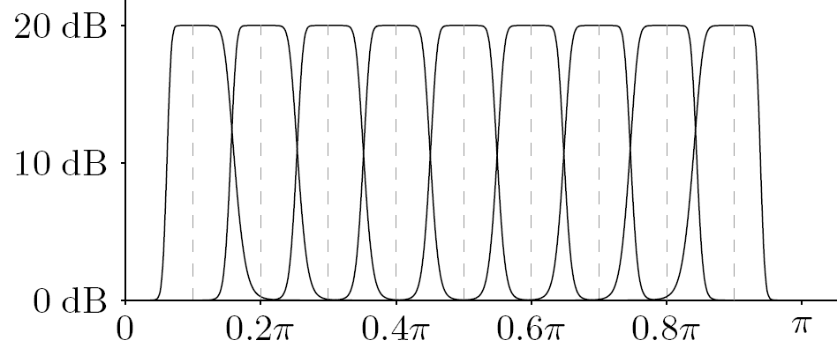
Design using shelving filters
Start with lowpass filter prototype
Use high-order Butterworth with cutoff ω_{u,i} -ω_{l,i}
Use lowpass to bandpass transformation formula
Then convert bandpass filter to shelving filter
Shelving filters placed in series
Are these shelving
or bandpass filters?
From M. Holters and U. Zölzer, "Graphic Equalizer Design Using Higher-Order Recursive Filters," 9th Digital Audio Effects Conf. (DAFx) , 2006.
Notes:
Note: plot is shelving filters since y axis is in db

Slide 23
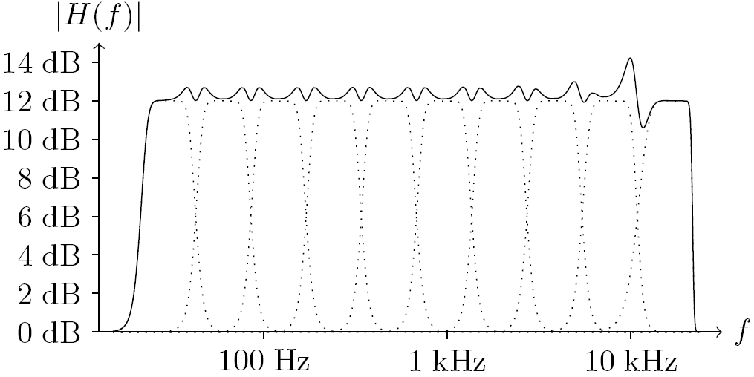
Octave equaliser
For 10-band octave equaliser
Magnitude response with 8th-order band-shelving filters, equal (12dB) gain [dotted = individual, solid = sum]:
From M. Holters and U. Zölzer, "Graphic Equalizer Design Using Higher-Order Recursive Filters," 9th Digital Audio Effects Conf. (DAFx) , 2006.

Slide 24
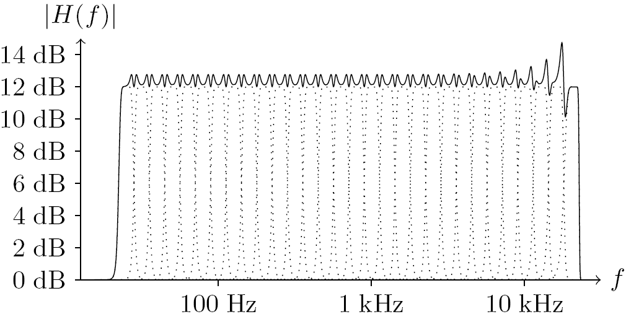
1/3-octave equaliser
For 30-band 1/3-octave equaliser
Magnitude response with 8th-order band-shelving filters, equal (12dB) gain [dotted = individual, solid = sum]:
From M. Holters and U. Zölzer, "Graphic Equalizer Design Using Higher-Order Recursive Filters," 9th Digital Audio Effects Conf. (DAFx) , 2006.

